Slide 1
PHONEBOOK Application
Phonebook is a console application without graphics. Phonebook is a very simple project that can help to understand the basic concepts of functions, file handling, class and object. This application will teach how to add, list, modify or edit, search and delete data to/from the file.

Slide 2
Features of phonebook
1. Add phone record: This features adds a new phone record to the file. It asks for the phone number and name of the person whose record is to be created.
2. Search phone records: This function is very simple, and with it users can search for a phone record either by providing the phone number or by the name of a particular person whose record has already been added in the file.
3. Show phone records: In phonebook management system, this feature allows user to list all the phone records stored in file.
4. Modify phone record: This simple feature allows user to edit the phone number and person name corresponding to a particular phone record.
5. Delete phone record: This feature deletes added phone record from the file.

Slide 3
Functions used
void menu() – This function is used to display the main menu.
void start() – This functions calls the menu function mentioned above.
void got() – This function is use defined input function.
void back() – This function is used to go back to start.
void addrecord() – It adds a new Phonebook record.
void listrecord() – This function is used to view list of added records in file.
void modifyrecord() – This function is used to modify added records.
void deleterecord() – It deletes record from file.
void searchrecord() – It searches for added record by name.

Slide 4
Header files used
<iostream> - The C++ <iostream> header file declares a set of functions for standard Input/Output. It also defines I/O stream objects such as cin, cout, clog, etc.
<cstdio> - Input and Output operations can also be performed in C++ using the C Standard Input and Output Library (cstdio, known as stdio. h in the C language). This library uses what are called streams to operate with physical devices
<conio.h> - The conio. h is a non-standard header file used in C and C++ programming. This file contains console input-output functions which are mostly used by MS-DOS compilers.
<cstring> - The C++ <cstring> header file declares a set of functions to work with C style string (null terminated byte strings).
<windows.h> - h is a Windows-specific header file for the C++ programming languages which contains declarations for all of the functions in the Windows API, all the common macros used by Windows programmers, and all the data types used by the various functions and subsystems.

Slide 5
User Defined Input Function, got()
While I was searching for a new idea of input, I found the input process of passwords we commonly use in our daily life and I implemented that idea in my phonebook application.
Why I used got() over cin() :
Cin() stop reading a string after space but got() continues to read string even after space.
Got() stops reading the string only after seeing a new line character.
The entered character is immediately returned without waiting for the enter key.
Got() does not use any buffer to store the input character.

Slide 6
Slide continues
Got() function uses input from getch(), which stores all type of data from keyboard in form of ASCII codes. There are two ASCII codes used in defining the got() function.
ASCII value 8 = Backspace
ASCII value 13 = Carriage Return (reset the position to beginning)
Putch() function is also used to display the value stored in got() input function.

Slide 7
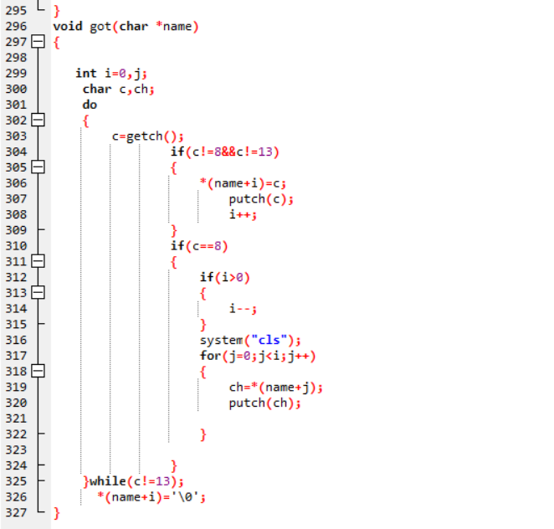

Slide 8
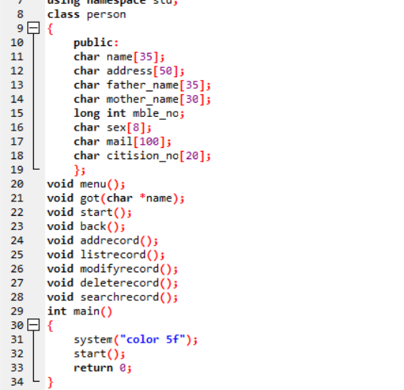

Slide 9
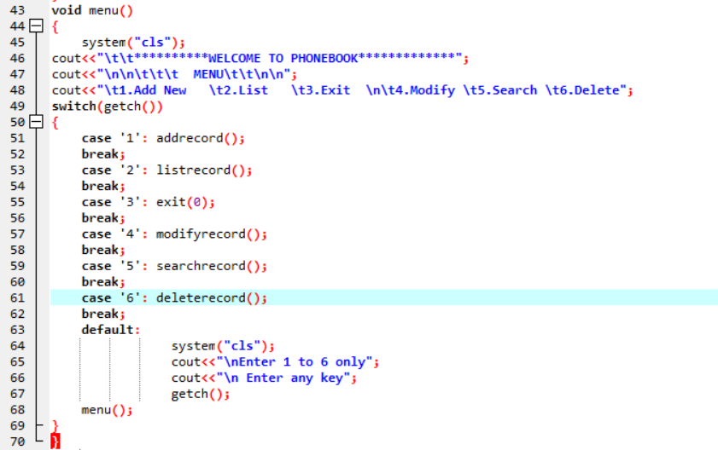

Slide 10
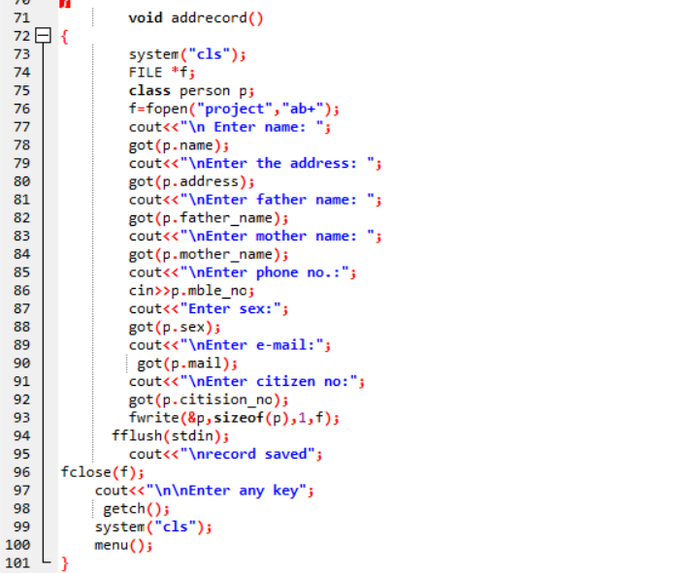

Slide 11
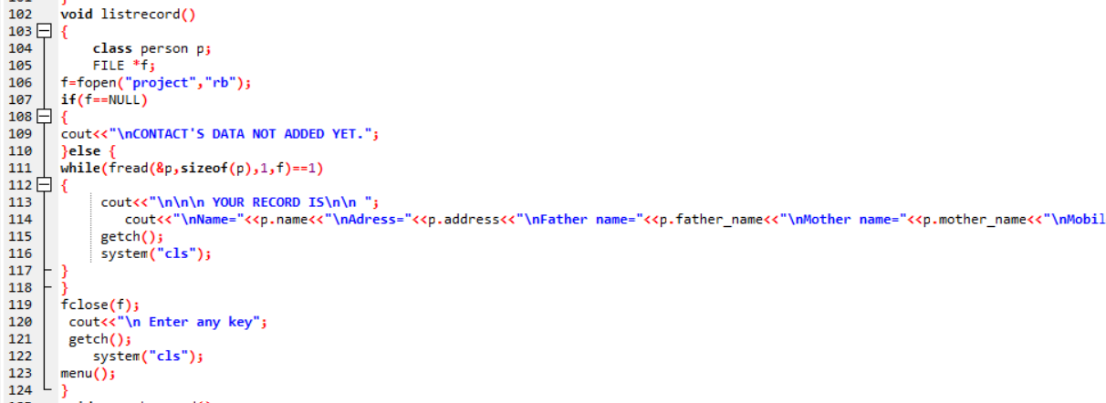

Slide 12
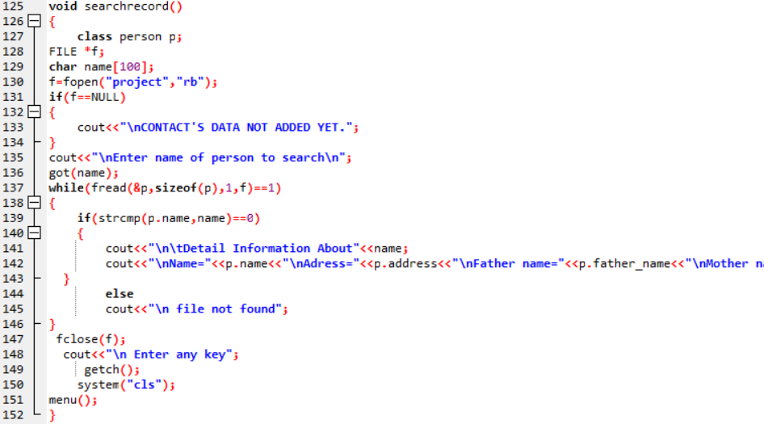

Slide 13
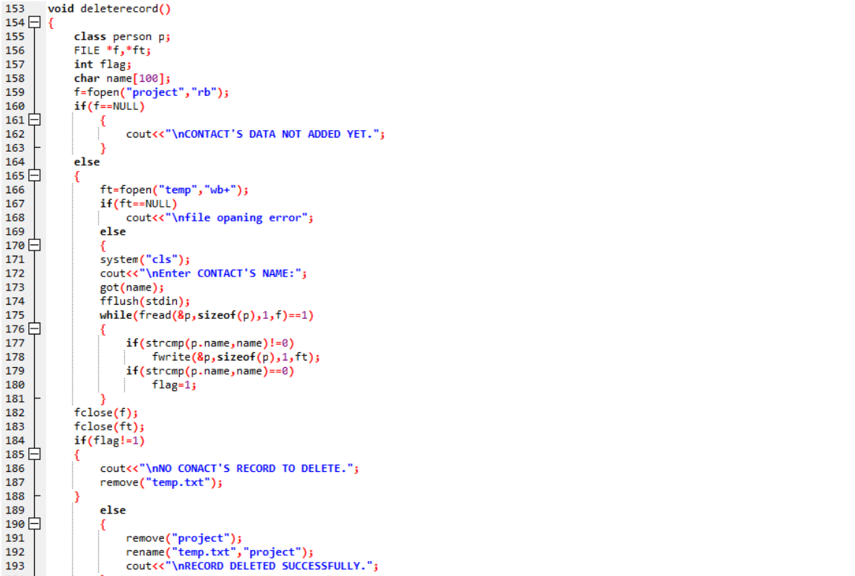
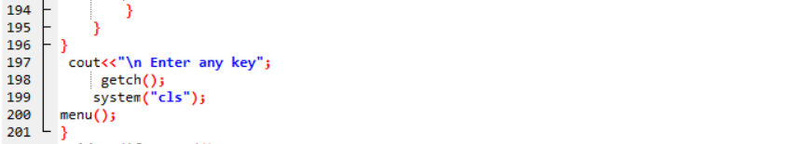

Slide 14
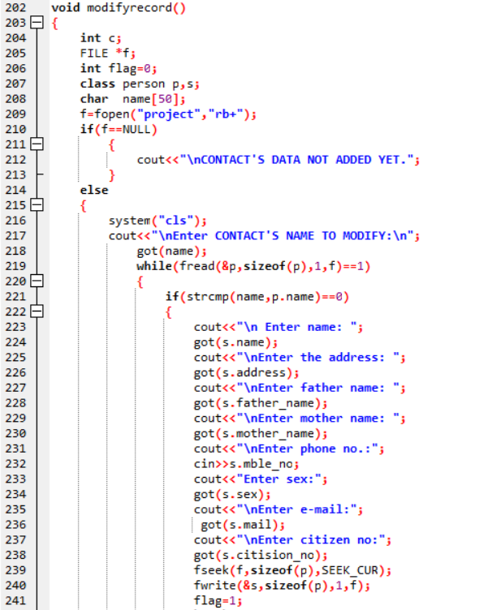
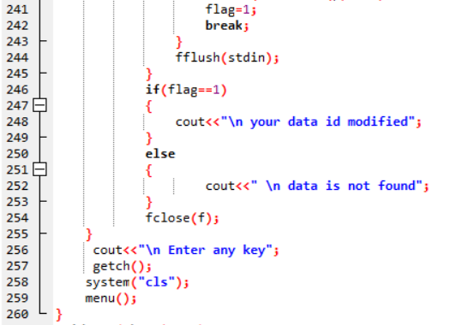

Slide 15
Result
.exe file at the desktop.

